Slide 1
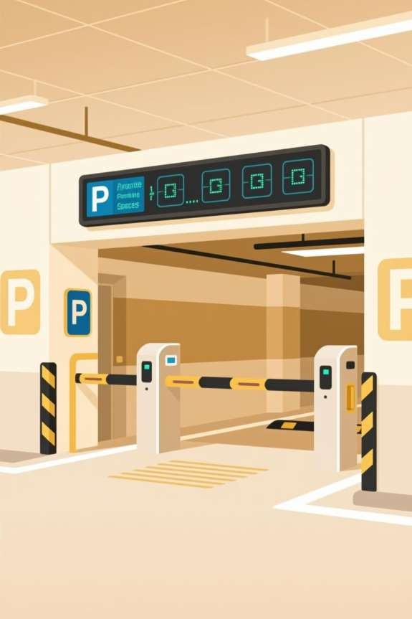
Intelligent Parking System
Verilog HDL and Embedded Systems
ACS College of Engineering – Department of Computer Science & Engineering

Slide 2

The Challenge: Parking in Smart Cities
Rapid Urbanization
Growing vehicle density strains traditional parking infrastructure
Inefficiency
Drivers waste time circling for available spaces, increasing emissions
Poor Visibility
No real-time slot availability information for parking facilities

Slide 3
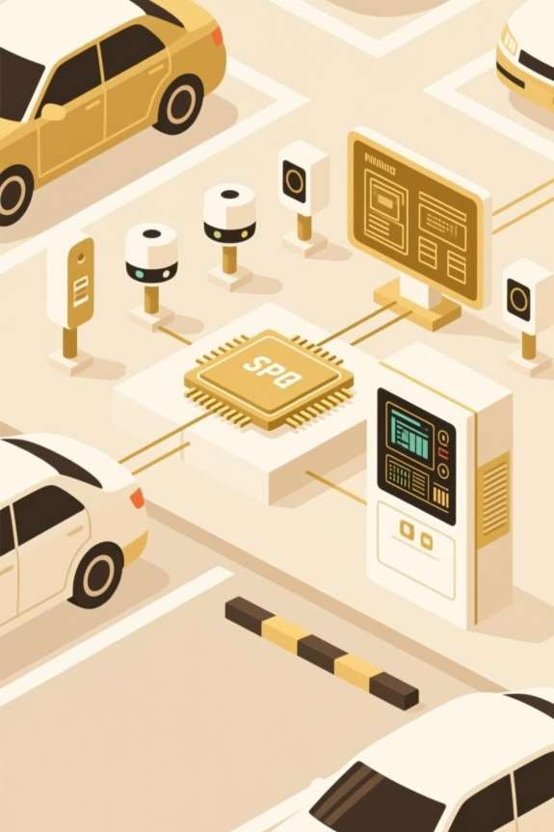

System Overview
An automated solution combining hardware detection with intelligent
digital logic and embedded interfaces for real-time parking management.
Vehicle Detection
IR sensors identify entry/exit
Verilog Logic
Hardware-based slot counting
Display Output
Real-time user interface

Slide 4

System Workflow
Vehicle Detection
IR sensors at entry/exit points detect vehicle presence
Signal Processing
Signals transmitted to Verilog module for logic evaluation
Slot Counter Update
Available parking slots incremented or decremented in real-time
Data Transmission
Microcontroller communicates via UART or serial interface
Display Update
LCD or LED shows available slots to users instantly

Slide 5
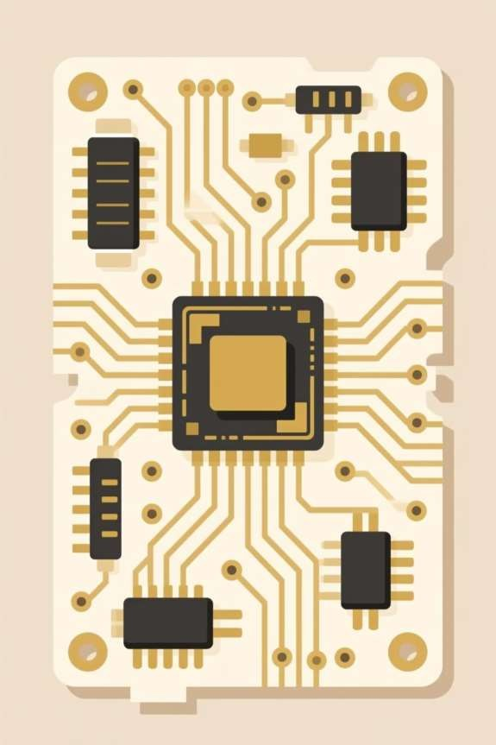
Technical Implementation
Future work
Embedded
Components
FPGA Development Kit
Verilog HDL Language
Icarus Verilog Simulator
ModelSim for Verification
Arduino/ARM Microcontroller
Embedded C Programming
UART Communication
Protocol
LCD/LED Display Driver

Slide 6
Core Verilog Module
Parking slot counter logic implemented in hardware:
module parking_system(input clk, rst, entry, exit,output reg [3:0] free_slots);
always @(posedge clk or posedge rst)
if(rst)free_slots <= 8;
else if(entry && free_slots>0)free_slots<= free_slots - 1;
else if(exit)free_slots <= free_slots + 1;
endmodule
Key Features: Synchronous design, real-time updates on clock pulse, automatic reset capability, overflow prevention

Slide 7
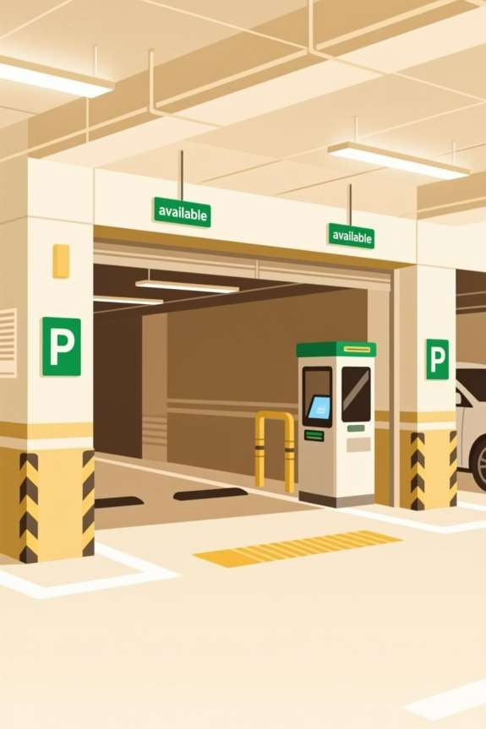
Key Advantages & Limitations
Advantages
⚠ Considerations
Real-time Monitoring: Instant slot availability updates
Low Cost: Affordable FPGA and
embedded hardware
Flexible: Easily programmable and reconfigurable
Fast Response: Hardware-based
logic ensures minimal latency
Scalable: Can expand to multi- floor systems
Sensor Calibration: Requires precise IR sensor tuning
Memory Constraints: Limited
slots per FPGA capacity
Environmental Factors: Weather may affect sensor accuracy
Integration Complexity: Multiple system components require testing

Slide 8
System Performance & Applications
<5ms
Detection Latency
Hardware response time for vehicle sensing
99%
Availability Accuracy
Real-time slot counting precision
8-32
Scalable Slots
Expandable parking capacity per zone
Applications: Commercial parking lots, airport facilities, smart city infrastructure, shopping complexes, corporate campuses,
multi-story parking structures

Slide 9
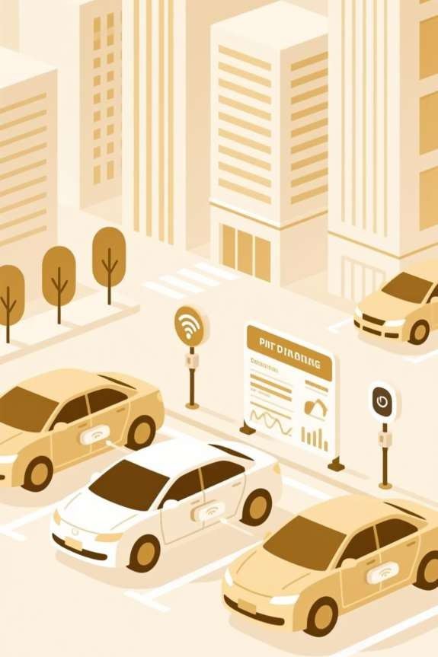
References & Conclusion
[1] IEEE: "Smart Parking System Using FPGA and Verilog HDL," IEEE
Xplore, 2023
[2] IEEE: "IoT-based Smart Parking Architecture for Urban
Management," IEEE Access, 2022

Slide 10
Conclusion
[3] Open-source Verilog projects and ModelSim simulation results
Project contributes to intelligent transportation systems through hardware-software co-design, enabling efficient urban parking management and reducing congestion in smart cities.

Slide 11
THANK YOU!

